Slide 1

DESIGN
Design criteria

Slide 2
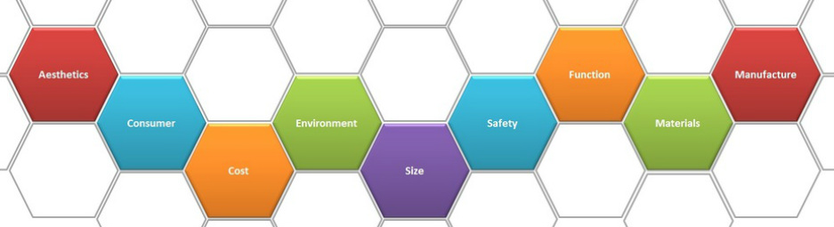
Design Criteria
Design criteria are the precise goals that you set to help a project be successful.
Over the following slides we will look at the type of goals you might want to think about.
To help use remember the sections, designers use the phrase ACCESS FM. Don’t worry if you don’t know the words we will go over them in the following slides.
This stands for Aesthetics, Customer, Cost, Ergonomics or Environment, Size, Safety, Function, Materials or Manufacture.

Slide 3
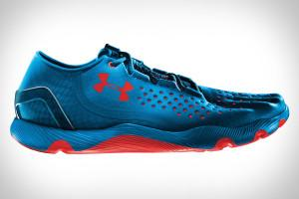
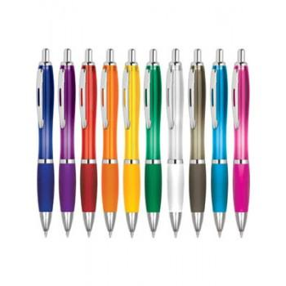
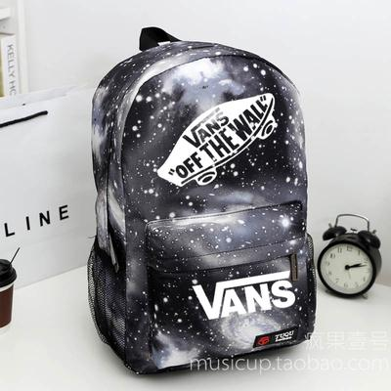
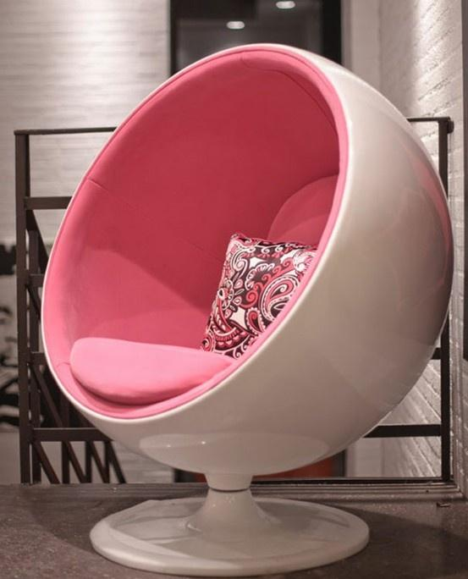
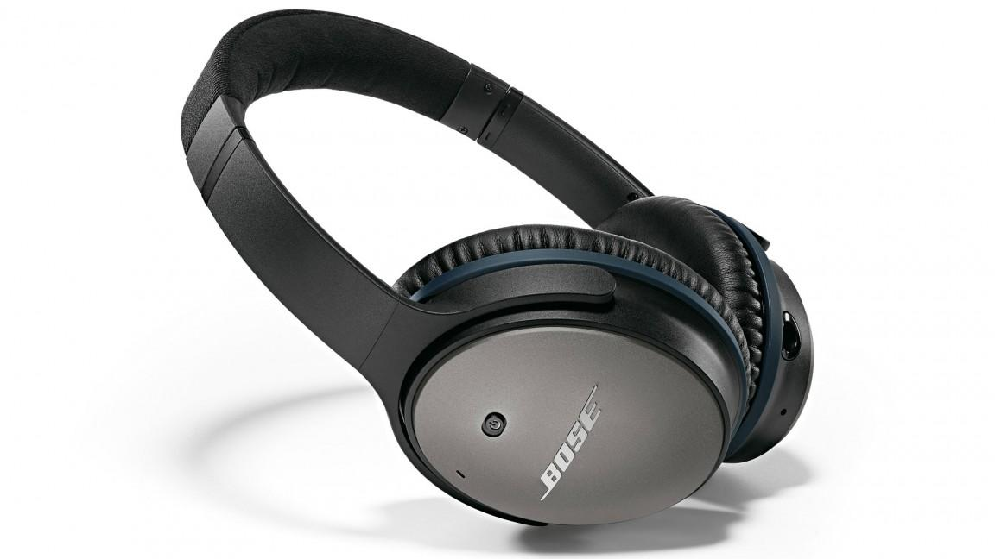
Design Criteria – Aesthetics (The way things look)
The sort of design criteria you might want to think about for this section are -
It’s outward shape
How it’s organised
It’s colour
Aesthetics
It’s simplicity
The 5 senses
It’s design style

Slide 4


Design Criteria – Customer
The sort of design criteria you might want to think about for this section are -
What job they do
What they don’t want it to do
Likes
Customer
What they want it to do
Dislikes
How they relax

Slide 5
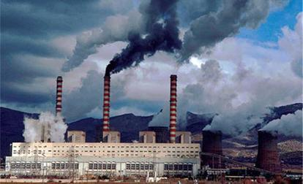




Design Criteria – Cost
The sort of design criteria you might want to think about for this section are -
Making
Time
Selling
Cost
Environment
Parts you buy
Material

Slide 6
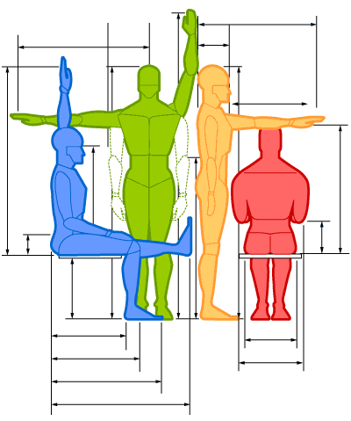
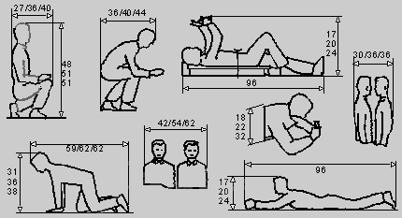

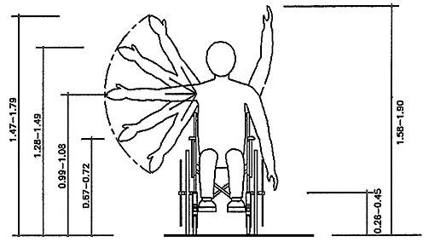
Design Criteria – Ergonomics
(The way things work with the human form)
The sort of design criteria you might want to think about for this section are -
How it’s held
Smallest size it can be
How you can fix it
Ergonomics
Biggest size it can be
Has it a grip
How hard can you grip it

Slide 7


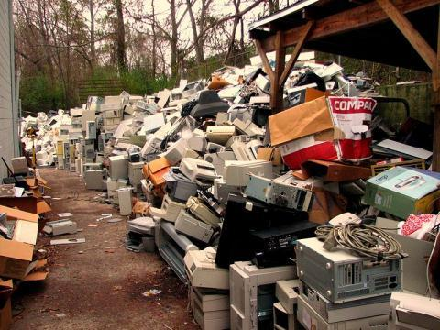


Design Criteria – Environment
The sort of design criteria you might want to think about for this section are -
Renewable material
The type of Glue & Paint
Non-renewable material
Environment
Transport of product
Toxic & Non-toxic
Carbon neutral

Slide 8
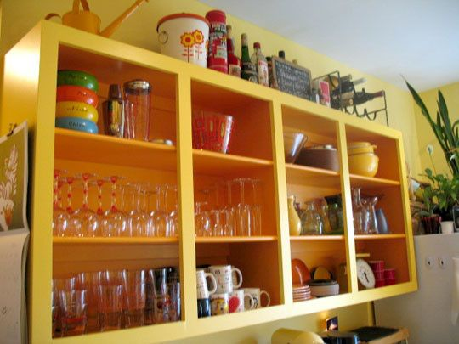
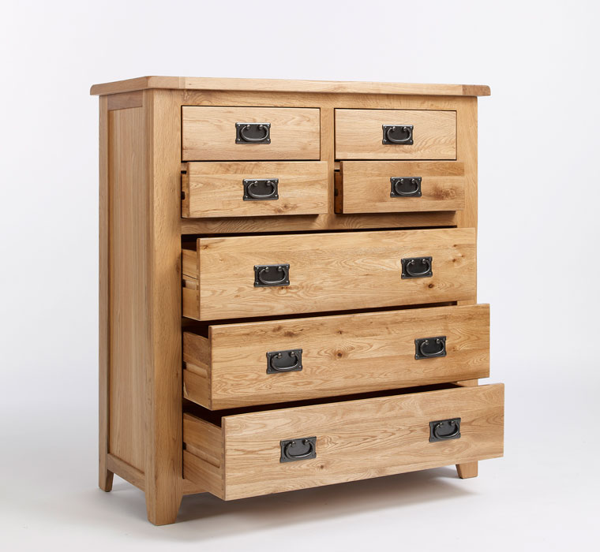

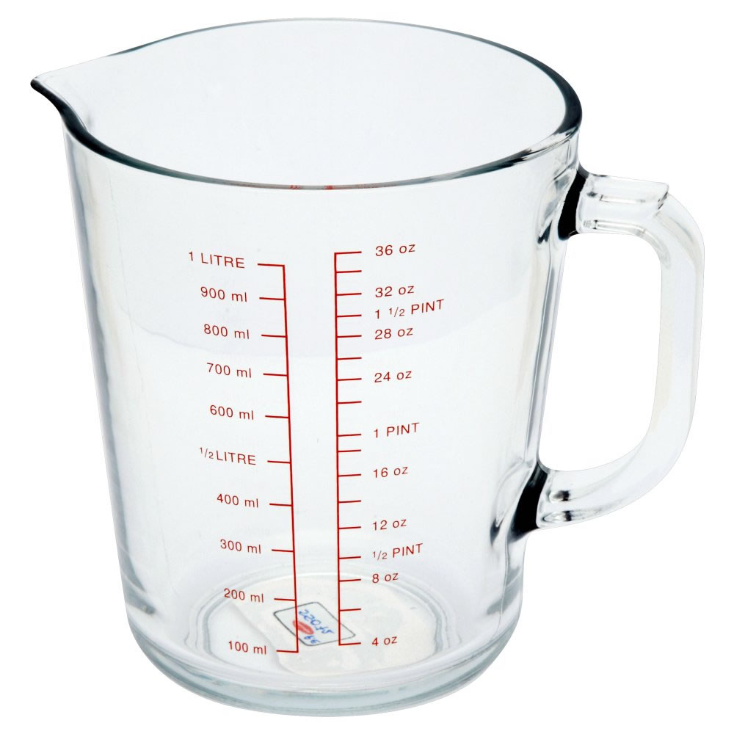
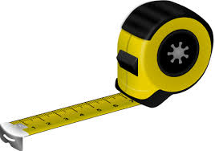
Design Criteria – Size
The sort of design criteria you might want to think about for this section are -
Physical dimensions
How it interacts with the user
Number of openings
Size
Volume contained
Sizes of openings
How much power

Slide 9
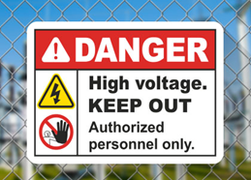

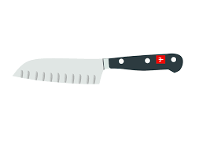

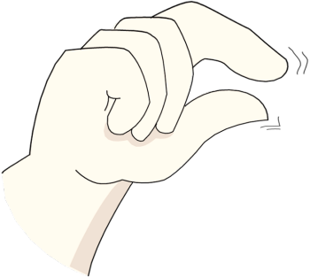

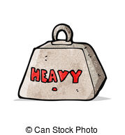
Design Criteria – Safety
The sort of design criteria you might want to think about for this section are -
Heavy or Light
Durable
Sharp or Blunt
Safety
Cut
Pinch
Trap

Slide 10
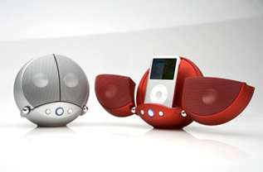
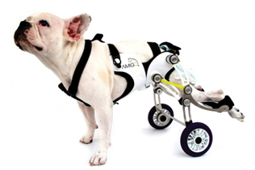
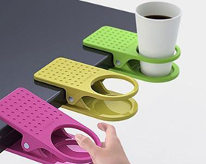
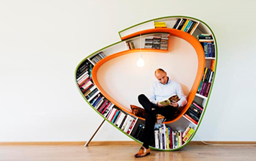
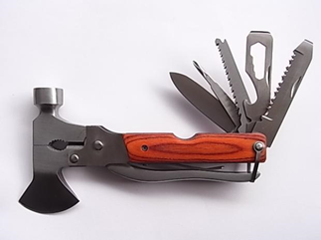
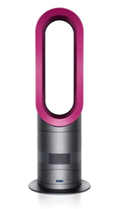
Design Criteria – Function (What it needs to do)
The sort of design criteria you might want to think about for this section are -
What it needs to do
How it is achieved
Function
How simple is it
Can it be successful

Slide 11
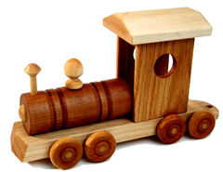
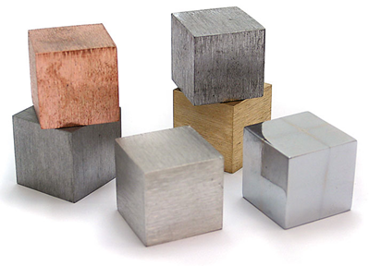
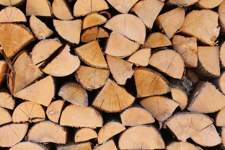
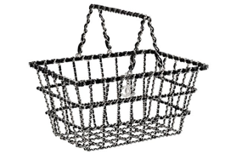
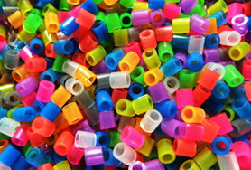
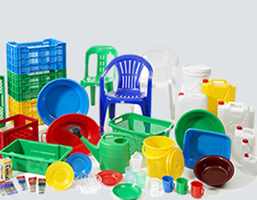
Design Criteria – Materials
The sort of design criteria you might want to think about for this section are -
Sustainable or Renewable
Wood, Metal, Plastic ….
Recyclable
Materials
Cost
Reuse
Environment

Slide 12
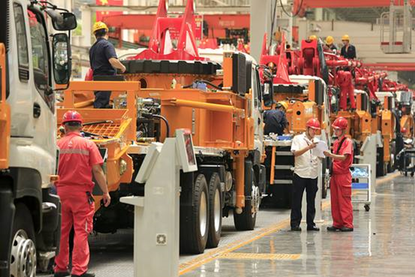
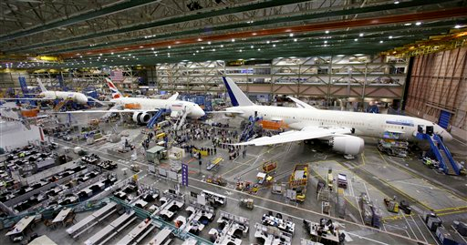
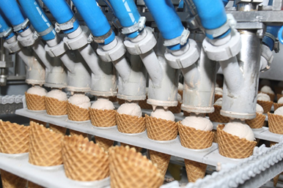
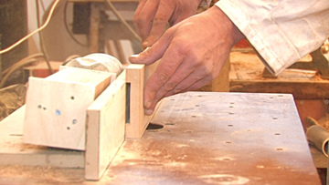
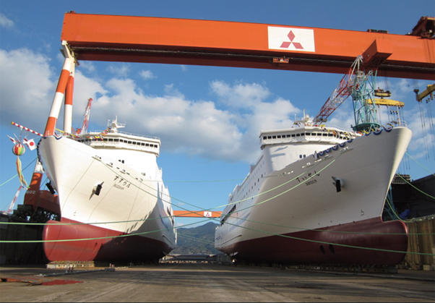
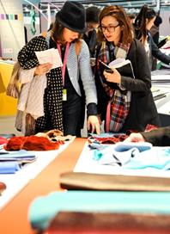
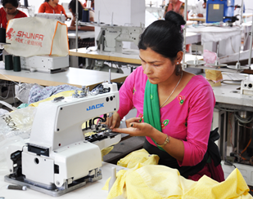
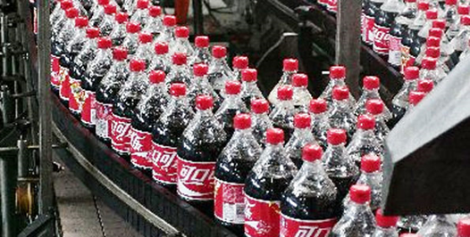
Design Criteria – Manufacture (How it’s made)
The sort of design criteria you might want to think about for this section are -
Sizes
How many you’re making
Tools
Manufacture
Paint, Varnish, Wax, Non
Machines
Order of work

Slide 13
Design Criteria – Overview
Remember you do not have to use every point just covered, you can choose which ones to have. You can also split the criteria into two groups, essential and desirable.

